Slide 1
HCBDA CAPSTONE PROJECT
Jennifer R. Duschak
Associate Business Data Analyst
November 10, 2023

Slide 2
Outline
Data Cleanup/Transformation Notes and Anomalies
Claims Time Analysis
Dashboard 1: Trend Overview
Dashboard 1.5: Outlier Deep-Dive
Statewide Analysis
Dashboard 2 – Geographical Distribution of Accidents
Policyholder Analysis:
Dashboard 3 – States with highest DUI related Accidents
Vehicle Analysis
Dashboard 4 – Sum and Average Settlement Discrepancy
Summary and Q & A

Slide 3
Data Cleanup/Transformation Notes and Anomalies
Initial Data cleanup and ETL
Data was converted to star schema via ETL process.
Original schema contained 10 tables, was normalized into one fact table and six dimension tables via ETL.
Data discrepancies on Policyholder Birth Date
Initial dataset had PH Birthdate ranging from 1907-2023 giving ages from 0-116 years old.
Reached out to project’s data engineer and confirmed this was an error in the data. Error was corrected.
Custom code was written to convert birthdates to age in order to facilitate analysis of age-related trends once dataset was linked to Tableau.

Slide 4
Data Cleanup/Transformation Notes and Anomalies
Accident type had duplicate Vandalism and Collision
Reached out to stakeholder, confirmed duplicate Vandalism was correct.
Wrote custom SQL to clean up Collision for Tableau.
Transformed Gender/Marital Status using custom SQL
Eliminate primary/secondary operator and marital status.
Put neutral category together.
Final categories: Male, Female, Neutral.
Created combined view of Age/State/DUI for further analysis in Tableau.
Cast Boolean values for DUI and At Fault as integer for simpler analysis.

Slide 5
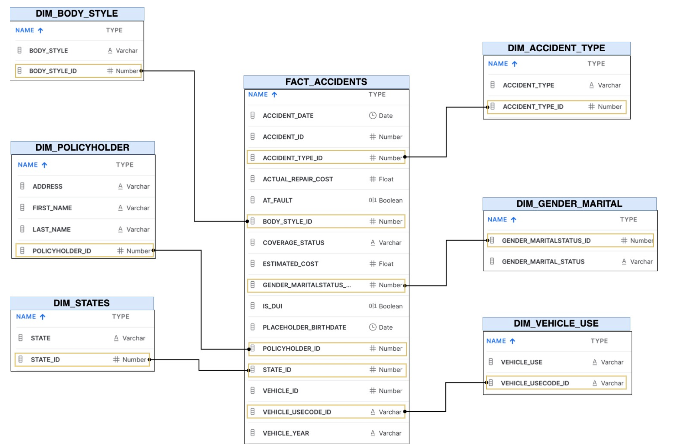
Data Cleanup/Transformation Notes and Anomalies

Slide 6
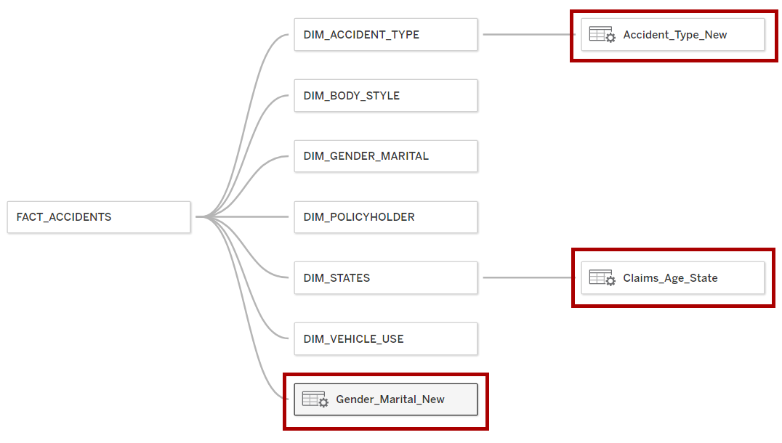
Data Cleanup/Transformation Notes and Anomalies

Slide 7
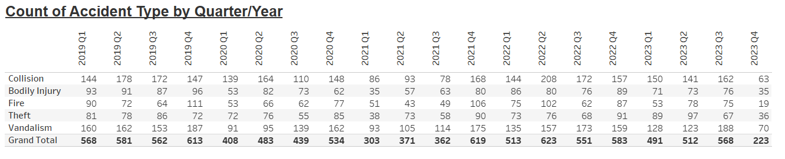
Claims Time Analysis
Dataset spans the timeframe 1/1/2019 through 11/1/2023
Monthly and Quarterly accident trends are very “jagged”
Every other month/quarter, the trend appears to reverse.
This is consistent across accident types.
Every loss type decreased in 2020, however 2021 had 2019 fewer accidents than 2020.
Collision claims increased 146% between the years 2021 and 2022.

Slide 8
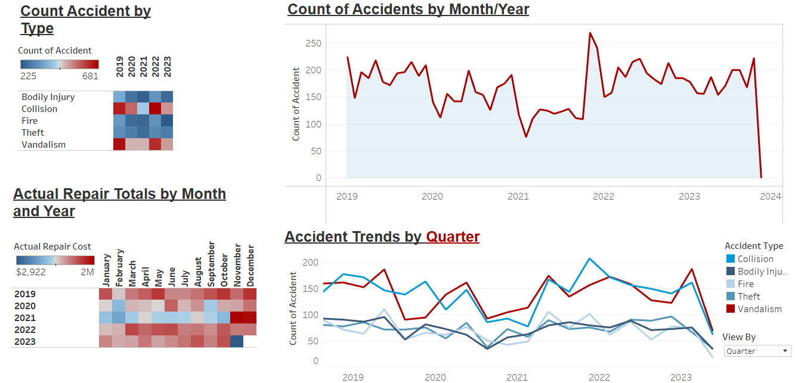
Dashboard #1 – Trend Overview

Slide 9
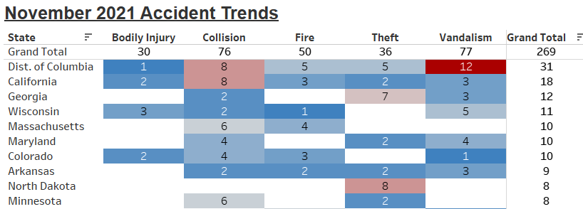
Claims Time Analysis
November 2021 stuck out as an outlier for peak accidents
Further analysis showed the primary drivers were Collision and Vandalism losses.
California and DC had the most overall losses.

Slide 10
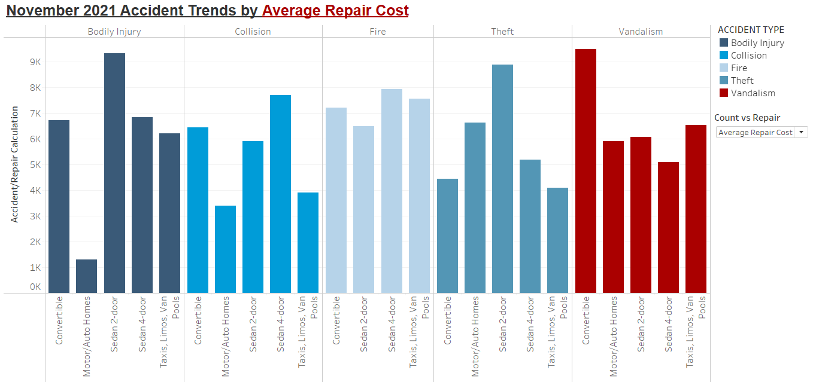
Dashboard #1.5 – Outlier Deep-Dive

Slide 11
Statewide Analysis
CA has largest dollar amount paid in Claim settlements ($5M), and also the youngest average age of 26.
CA is a large state, so this was not a surprising discovery.
WV has largest Average discrepancy between claim estimate and final cost. ($7,335)
District of Columbia has largest Total discrepancy between claim estimate and final cost. ($1.7M)
District of Columbia also has the highest DUI count and 2nd youngest average age of 28.
*Both WV/DC are small states by geographic area, so definitely raise red flags.
*We not know the total size of book of business in each state – this dataset is only for claims, and for a specific time frame.

Slide 12
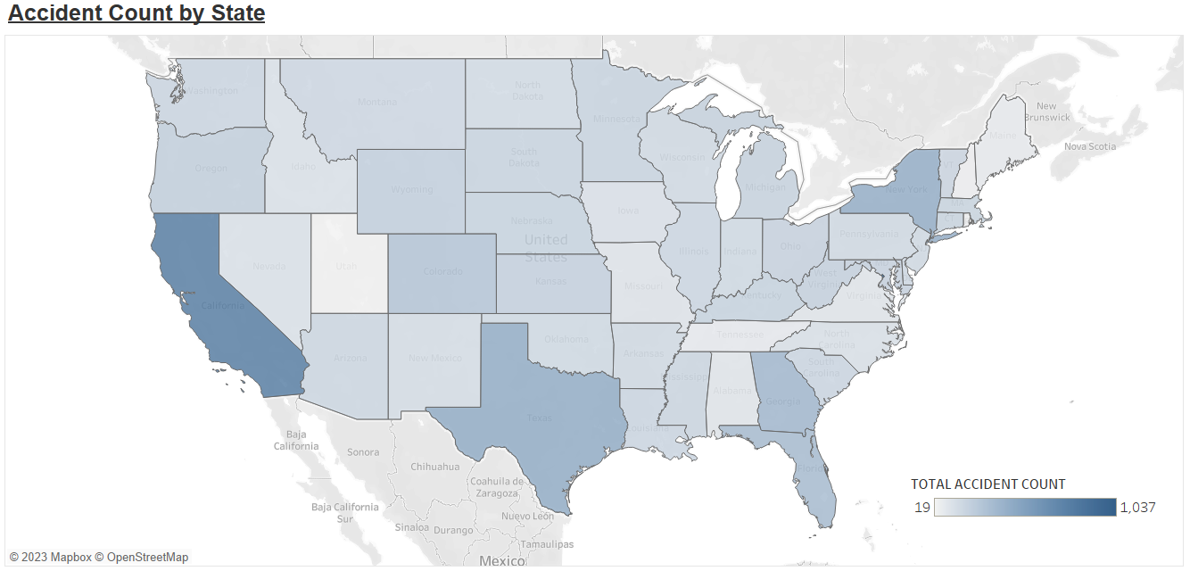
Dashboard #2 – Geographical Distribution of Accidents

Slide 13
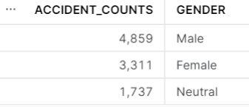
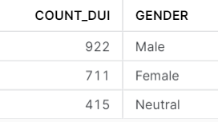
Policyholder Analysis
Minimum age = 18
Maximum age = 60
Average age = 35
Gender/Marital Analysis:
Males account for 45% of accidents and 49% of DUI.
Approx. 20% of accidents and DUI are attributed to a “Neutral” gender marker per the dataset.

Slide 14
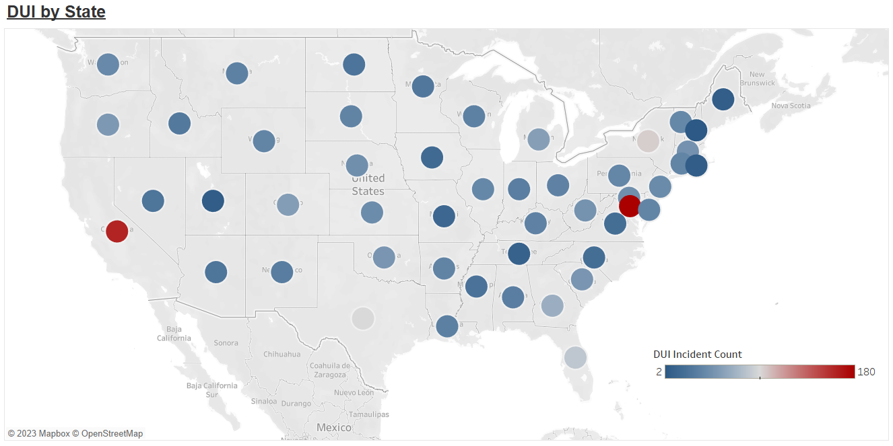
Dashboard #3 – States with highest DUI related Accidents

Slide 15
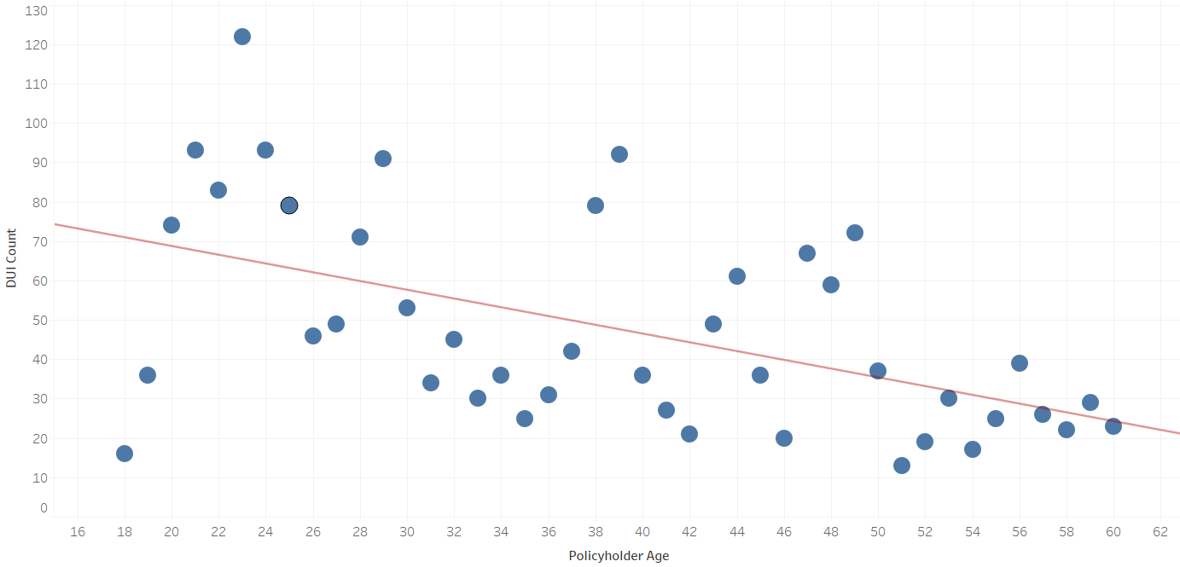

Policyholder Analysis
I further analyzed the DUI age trend, as the 2 highest DUI states also had the lowest average ages.
Testing the hypothesis that younger drivers were more prone to DUI, the resulting scatterplot returned a statistically significant P-value, indicating that age and DUI count is related.

Slide 16
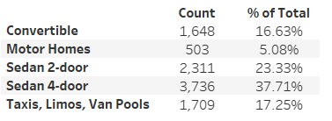
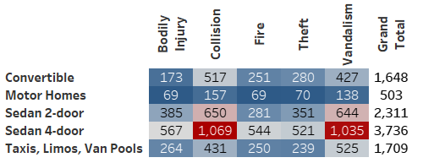
Vehicle Analysis:
Only 5 body styles are used Convertible, Motorhome, Sedan, and Taxi/Limo/Van Pool.
Initial Dataset had 23 styles
Sedans make up 61% of total vehicles in dataset (combining 2 and 4-door), so are most likely to contribute most to loss totals.
Accident type by body style:
Collision, Vandalism highest for all body styles.
Livery vehicles are more prone to Vandalism that other types

Slide 17
Repair Discrepancies Deep-Dive
Dataset included information on Estimated Repair costs and Actual Repair costs.
In exploring this further, I wanted to pursue any trends among repair cost discrepancies
Upon calculating a field for Repair Discrepancies (Sum and Average), noticed that West Virginia and District of Columbia were significant outliers in this area.
West Virginia had the highest AVERAGE discrepancy ($1,909) and District of Columbia had the highest TOTAL discrepancies ($1,699,641.)
Created dashboard to visualize these discrepancies.

Slide 18
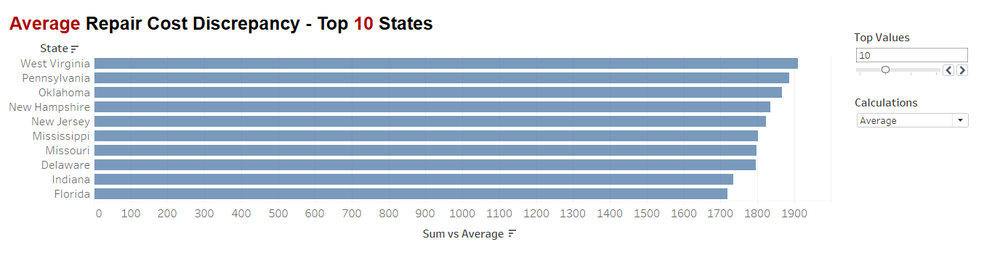
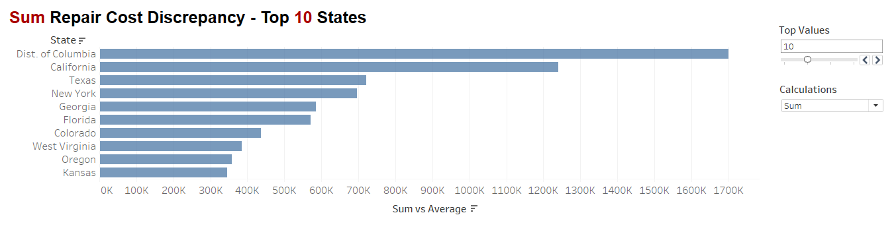
Dashboard #4 – Sum and Average Settlement Discrepancy

Slide 19
Summary
Initial dataset had a few anomalies and required some cleaning, but after some discussion with my stakeholders and SMEs, I was able to resolve.
Younger drivers are prone to DUI. Perhaps look into some sort of education program for younger drivers – especially around DUI. Propose a driver education credit.
District of Columbia and West Virginia have the highest discrepancies in estimates vs. payout.
District of Columbia appears to be an outlier on many different factors. Perhaps we need to consider the drivers for this, and given it is such a small geographical area, perhaps consider a moratorium on writing new business in this area.

Slide 20
Q&A

